Slide 1
Service Desk

Slide 2
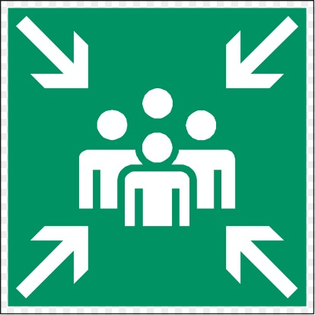
What Is the Purpose of a Service Desk?
PURPOSE: To capture demand for incident resolution and service requests
Should act as a Single Point of Contact
Enable communication from and to the users
Has a major influence on user experience and perception

Slide 3
Different Types of Service Desks
Local
Located in the same place with the customer
Understanding and acting on the business context is an essential skill
They must demonstrate excellent customer service, empathy and emotional intelligence
Central
Centralized, providing remote support
Virtual
Can be located anywhere, but depend on the tools to collaborate and communicate

Slide 4


Different Technologies Useful for the Service Desk
Robotic Process Automation (RPA) and chatbots with AI
Interactive Voice Response (IVR) and Automatic Call Distribution (ACD)
Computer Telephony Integration (CTI) and remote access
Diagnostic scripts and knowledge bases
Self-Service tools for the users

Slide 5
The Better Tools They Have, the More They Can Focus on Human Interaction!

Slide 6
Relationship Management
Next Video

